Slide 1



Executive summary
People Matter Survey 2018
KERANG DISTRICT HEALTH

Slide 2
Introduction
This presentation provides an overview of your organisation's key People Matter Survey results for 2018.
More detailed results can be found in your benchmark and result reports.
Your organisation achieved a 68% response rate with 101 responses.

Slide 3
Contents
Section | Page | Topic
4 |  | Comparator group
1. Headline benchmarks | 5 | Public sector values
 | 6 | Employment principles
 | 7 | Supporting measures and negative behaviours
2. Key indicators | 8 | Employee engagement – Key factors
 | 9 | Employee engagement – Key factor description
 | 10 | Employee engagement – How you compare
 | 11 | Respectful workplaces
 | 12 | Safe and supportive environment
 | 13 | Diversity and engagement
3. Question benchmarks | 14 | Highest scoring questions in 2018
 | 15 | Highest scoring questions relative to comparator group
 | 16 | Questions with the most improvement on 2017
 | 17 | Lowest scoring questions in 2018
 | 18 | Lowest scoring questions relative to comparator group
 | 19 | Questions with the greatest deterioration on 2017

Slide 4
Comparator group
4
The following slides include comparisons with PMS survey results for your
comparator group:
Alexandra District Health | Alpine Health | Beaufort and Skipton Health Service
Beechworth Health Service | Boort District Health | Casterton Memorial Hospital
Cobram District Health | Cohuna District Hospital | Corryong Health
East Wimmera Health Service | Edenhope and District Memorial Hospital | Heathcote Health
Hepburn Health Service | Hesse Rural Health Service | Heywood Rural Health
Inglewood and Districts Health Service | Kilmore and District Hospital | Kooweerup Regional Health Service
Kyneton District Health Service | Lorne Community Hospital | Maldon Hospital
Mallee Track Health and Community Service | Mansfield District Hospital | Moyne Health Services
Nathalia District Hospital | Numurkah District Health Service | Omeo District Health
Orbost Regional Health | Otway Health & Community Services | Robinvale District Health Services
Rochester and Elmore District Health Service | Rural Northwest Health | Seymour Health
South Gippsland Hospital | Tallangatta Health Service | Terang and Mortlake Health Service
Timboon and District Healthcare Service | Yarram and District Health Service | Yarrawonga Health
Yea and District Memorial Hospital
Some slides also show results for the whole survey sample (194 organisations).

Slide 5
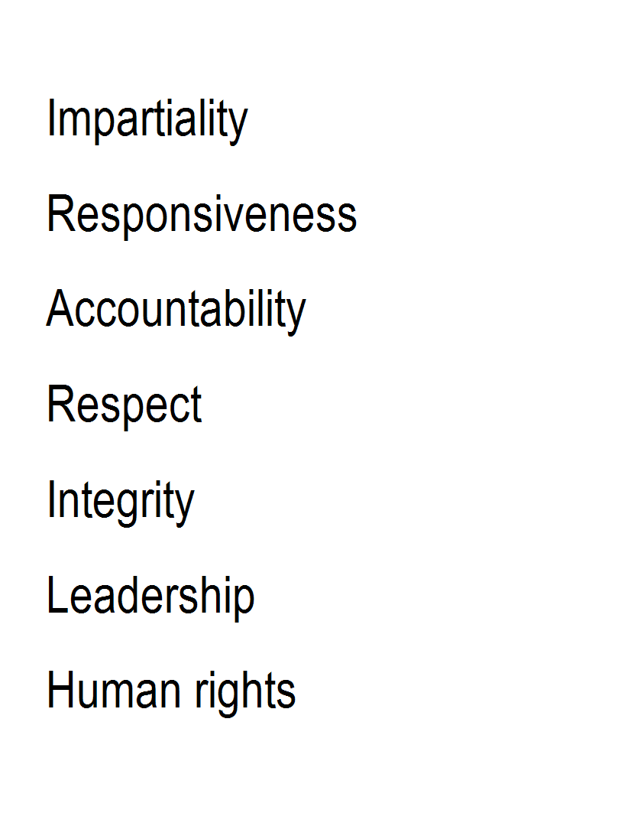
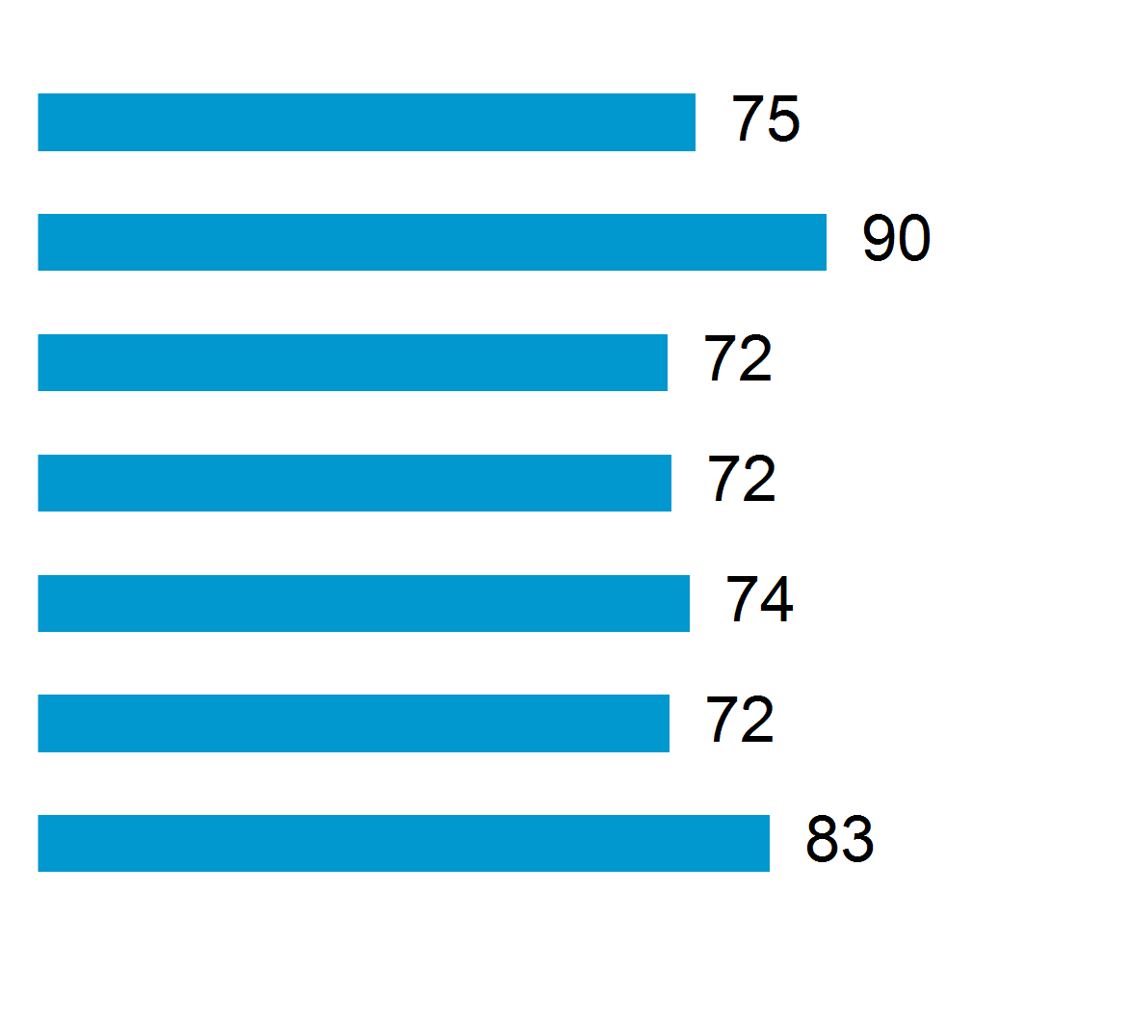
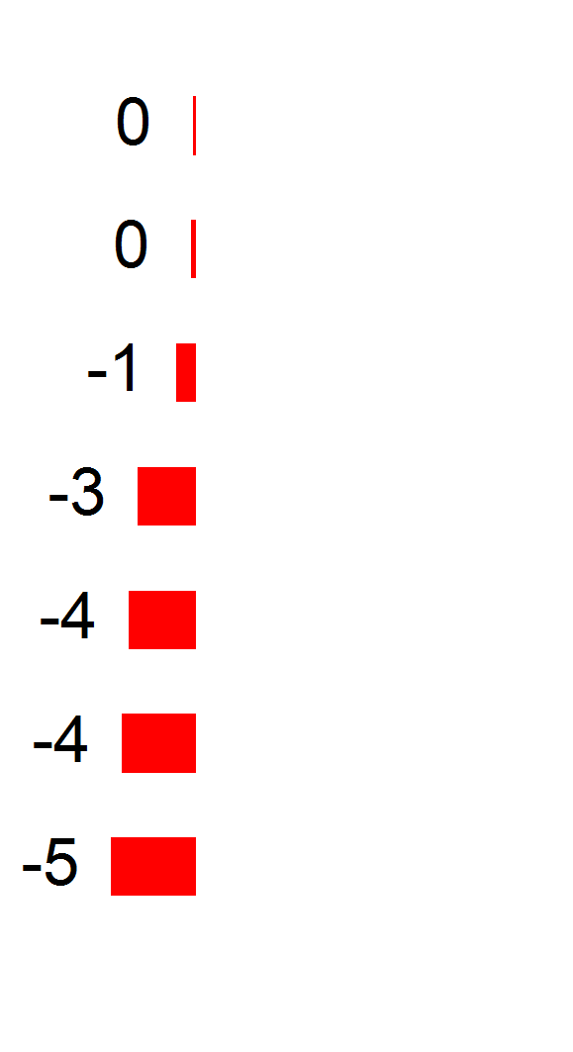
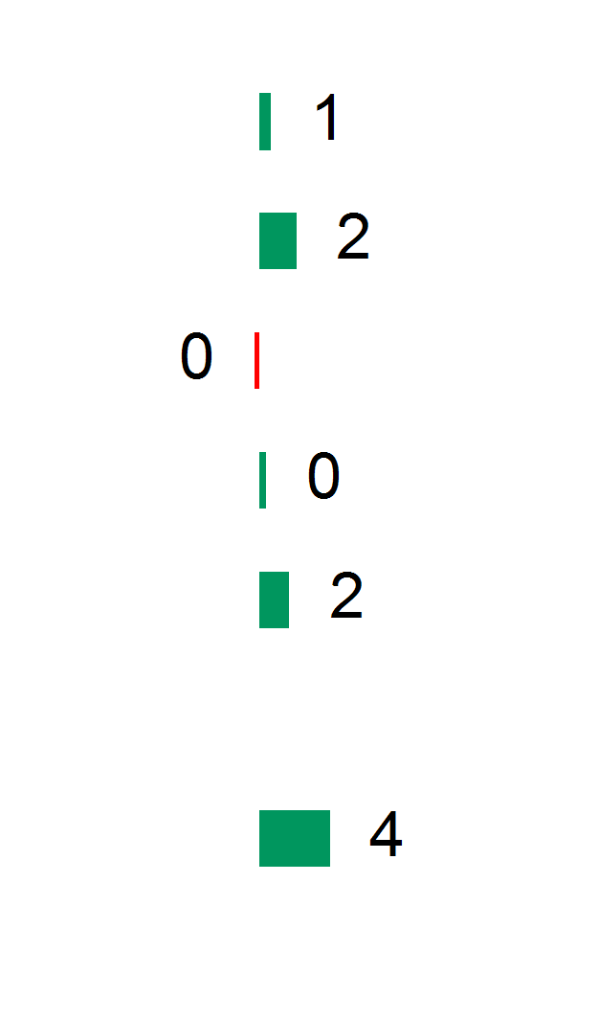
1. Headline benchmarks
Public sector values
5
Values
Your results
Variance from comparator group
Variance from your 2017 survey
Average positive agreement %
Percentage point differences
Please note: It is not possible to compare these headline benchmarks to those in PMS reports from earlier years. There has been a reduction in the number of questions about each value in the 2018 survey. The 2017 results used on this page are based on the questions retained in the 2018 survey.

Slide 6
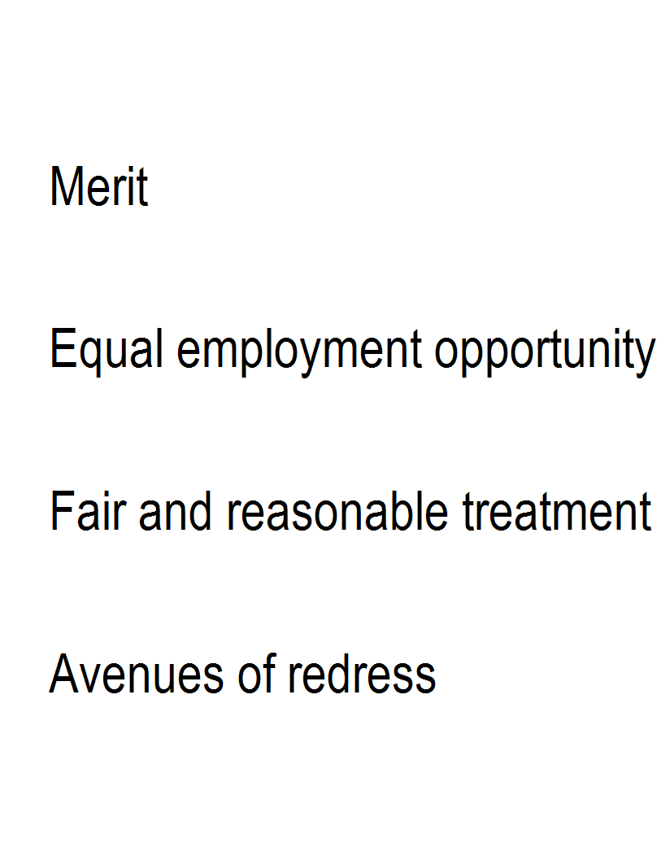
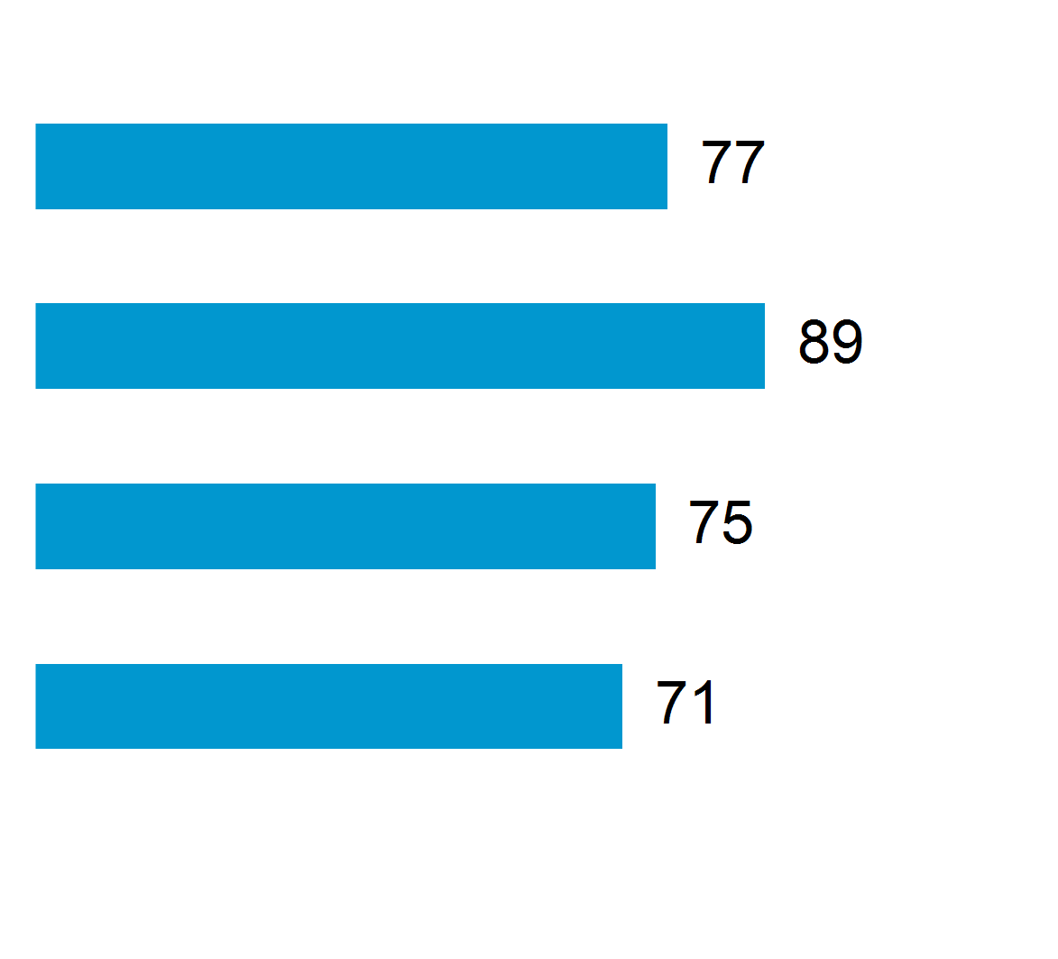
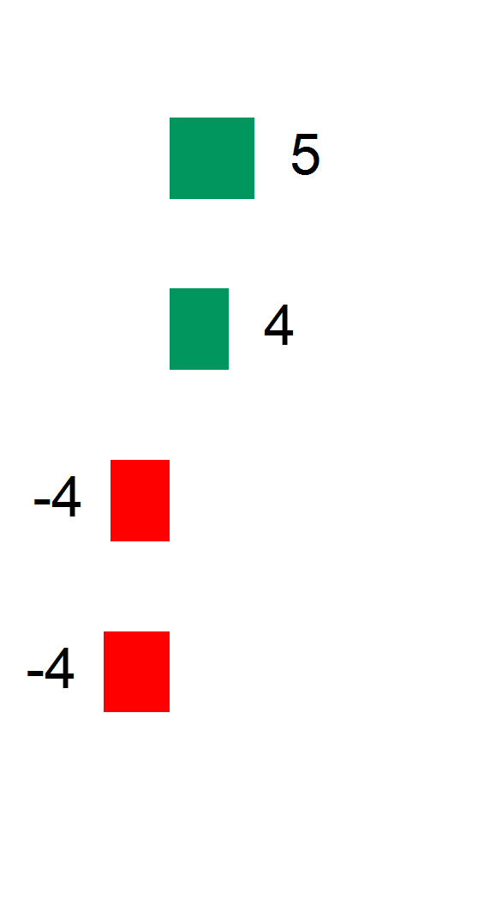
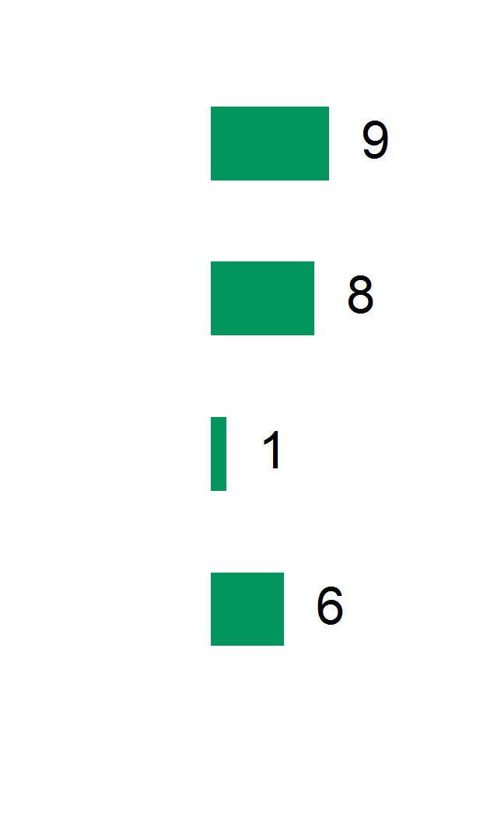
1. Headline benchmarks
Employment principles
6
Principles
Your results
Variance from comparator group
Variance from your 2017 survey
Average positive agreement %
Percentage point differences
Please note: It is not possible to compare these headline benchmarks to those in PMS reports from earlier years. There has been a reduction in the number of questions about each value in the 2018 survey. The 2017 results used on this page are based on the questions retained in the 2018 survey.

Slide 7
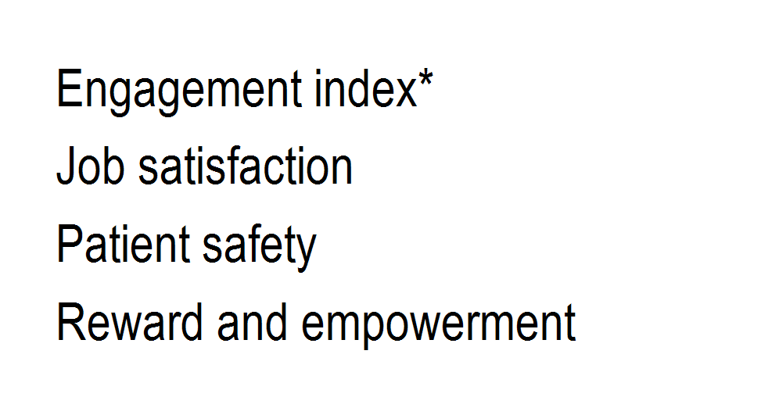
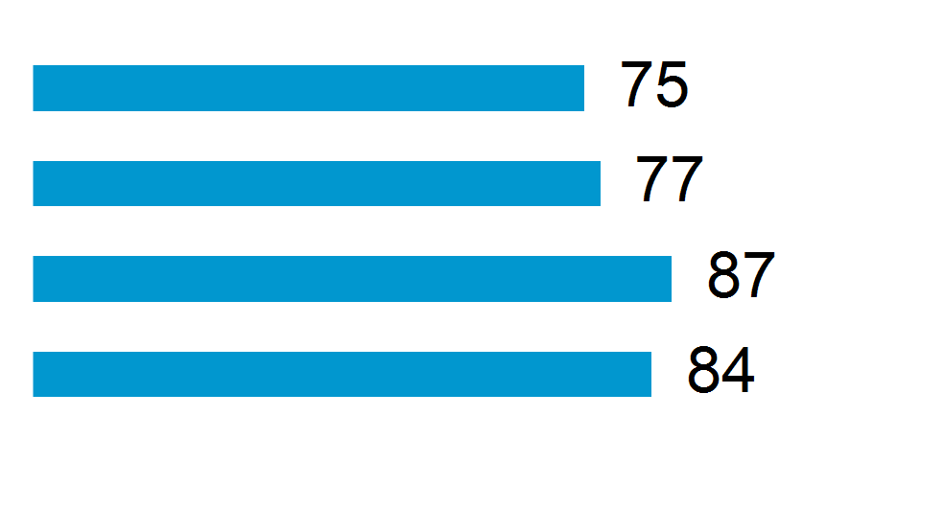
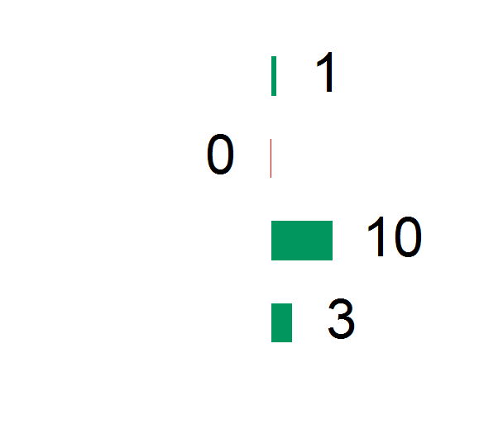
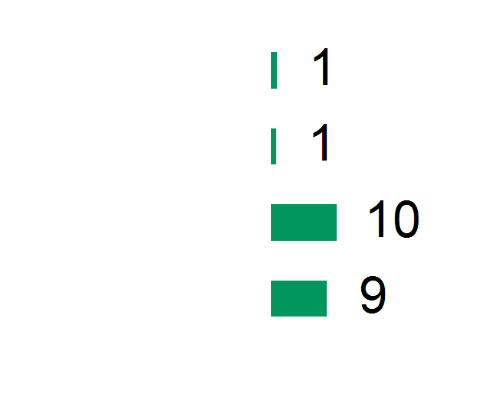
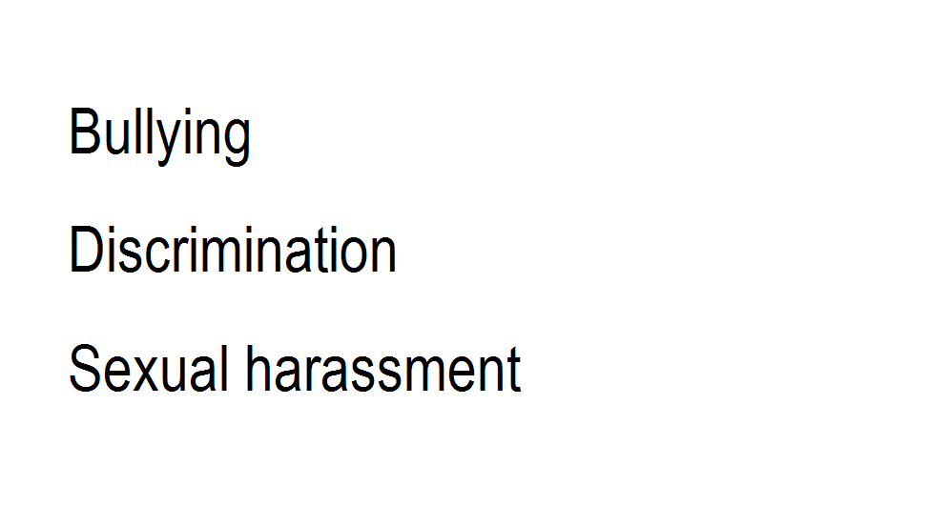
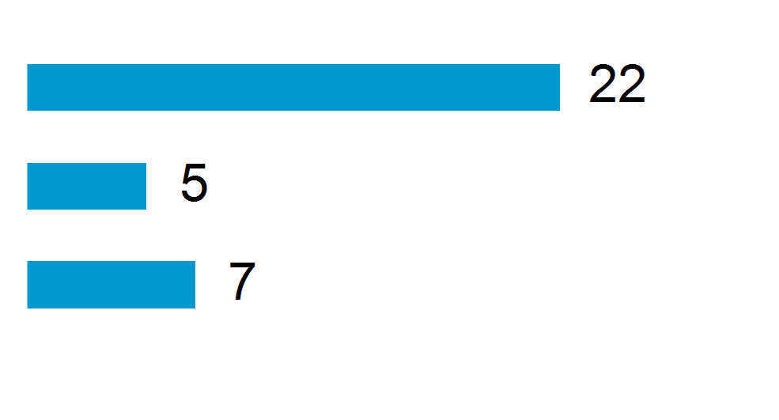
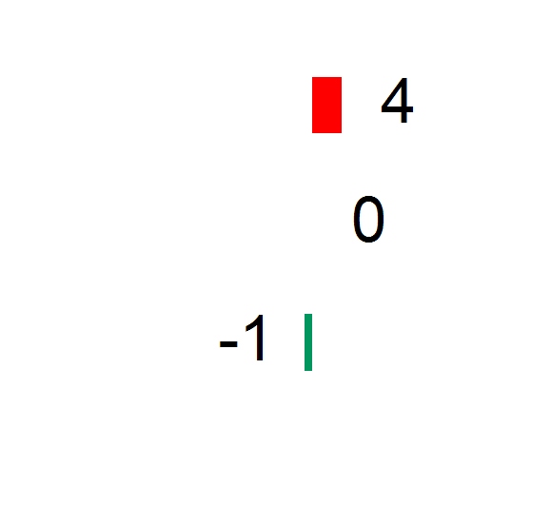
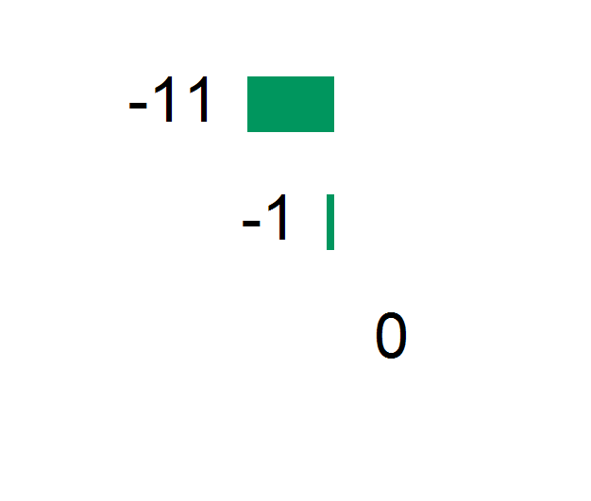
1. Headline benchmarks
Supporting measures and negative behaviours
7
Measures / Behaviours
Your results
Variance from comparator group
Variance from your 2017 survey
Average positive agreement %
Percentage point differences
Experienced %
Percentage point differences
*Engagement index: Each respondent is given a score for each engagement question where strongly agree equates to 100 points, agree equates to 75 points, neither agree nor disagree equates to 50 points, disagree equates to 25 points and strongly disagree equates to 0 points. The engagement index is the average of these scores.

Slide 8
2. Key indicators
Employee engagement - key factors
8
The PMS measures employee engagement using five “say, stay, strive” questions that cover pride, advocacy, attachment, inspiration and motivation. Engagement has been linked to organisation performance, productivity and employee health and wellbeing.
PMS data and international research indicates the following factors are powerful predictors of employee engagement:
Reward and empowerment: employees who enjoy their work, use their skills, have a sense of accomplishment, receive adequate recognition, and have the authority to do their job effectively are much more likely to be engaged.
Effective leadership: employees are more likely to be engaged when leaders are perceived as role models who provide clear strategy and direction.

Slide 9
2. Key indicators
Employee engagement - key factor description
9
PMS questions that measure the key factors:
Reward and empowerment Effective leadership
I enjoy the work in my current job | Senior managers provide clear strategy and direction
I get a sense of accomplishment from my work | Senior managers model my organisation's values
I receive adequate recognition for my contributions and accomplishments
I have the authority to do my job effectively
My job allows me to utilise my skills, knowledge and abilities

Slide 10
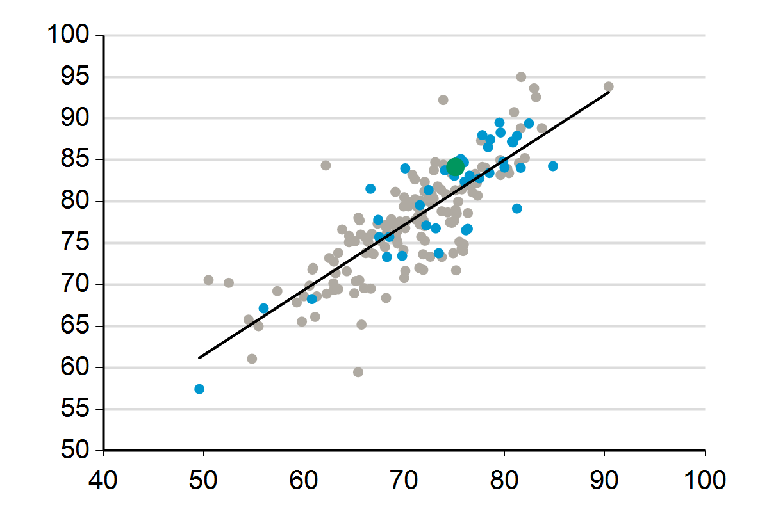
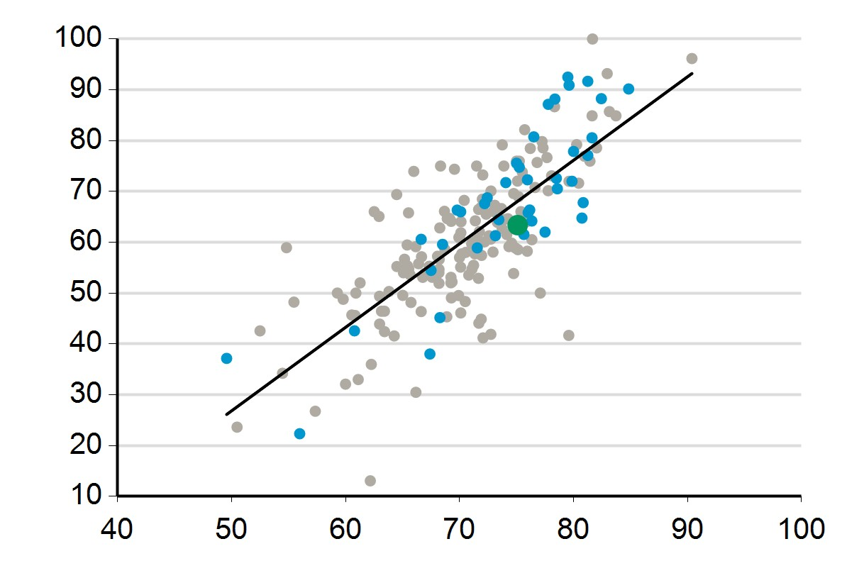
2. Key indicators
Employee engagement - how you compare
10
Organisations that score highly on reward and empowerment and effective leadership have higher levels of engagement.
Key: • Kerang District Health
• Comparator organisations • Other organisations
Reward and empowerment
Average positive agreement %
Effective leadership
Average positive agreement
%
Engagement index*
Engagement index*
*Engagement index: Each respondent is given a score for each engagement question where strongly agree equates to 100 points, agree equates to 75 points, neither agree nor disagree equates to 50 points, disagree equates to 25 points and strongly disagree equates to 0 points. The engagement index is the average of these scores.

Slide 11
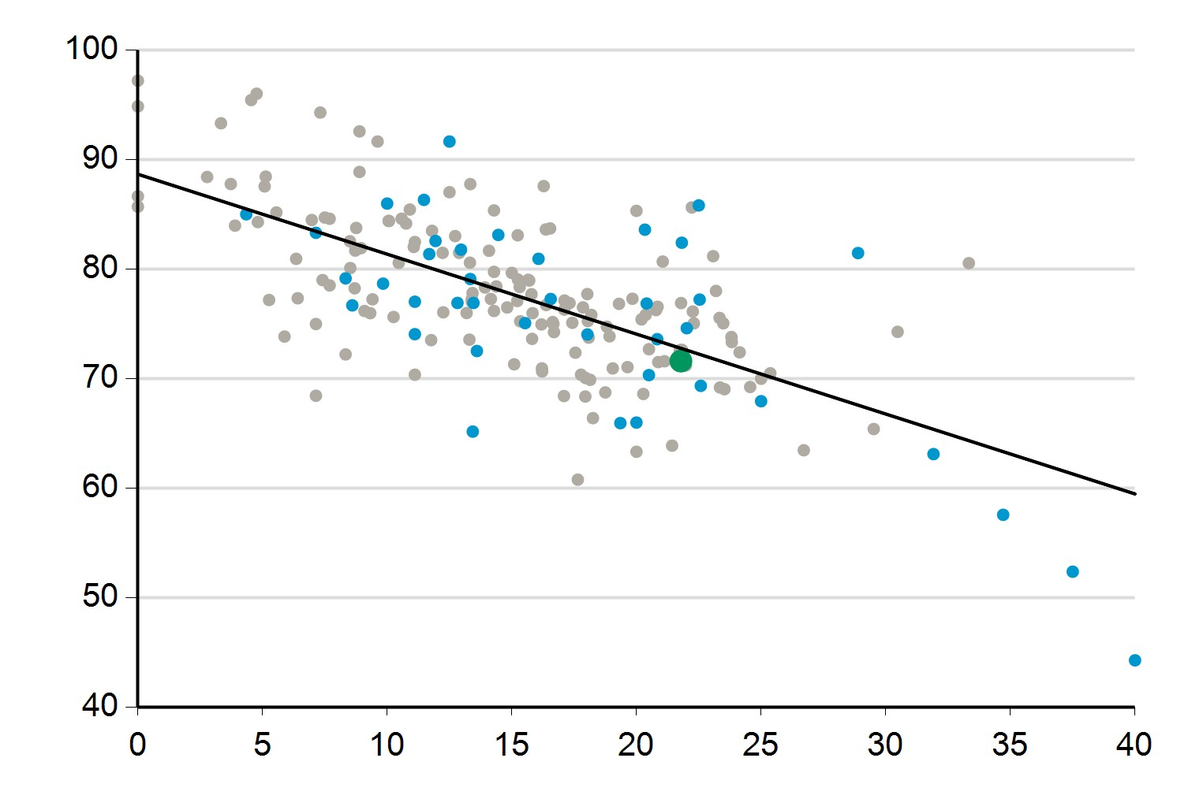
2. Key indicators
Respectful workplaces
11
Bullying is less prevalent in organisations with respectful workplaces.
Key: • Kerang District Health
• Comparator organisations • Other organisations
Respectful workplaces questions
People in my workgroup treat each other with respect
My manager listens to what I have to say
My manager keeps me informed about what's going on
Respectful workplaces
Average positive agreement %
Bullying
Experienced %

Slide 12
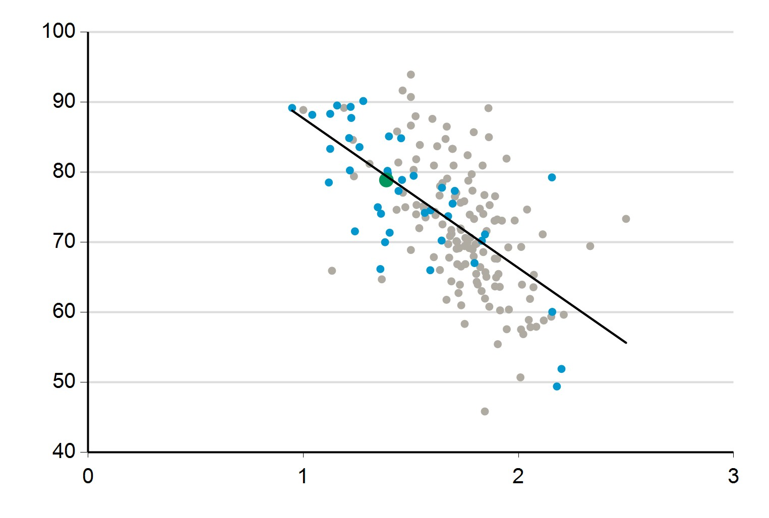
2. Key indicators
Safe and supportive environment
12
Workplace stress is lower in organisations that provide a safe and supportive environment.
Key: • Kerang District Health
• Comparator organisations • Other organisations
Safe and supportive environment questions
My organisation provides a safe work environment
My organisation encourages and supports employees to have a good work/life balance
My organisation has effective procedures in place to support employees who may experience stress
Safe and supportive environment
Average positive agreement %
Mild Moderate
Average level of work related stress
High
Work related stress: To the question, “How would you rate your current, overall stress level in relation to work- related stress?”, respondents could pick: nil (0), mild (1), moderate (2), high (3), very high (4) or severe (5).

Slide 13
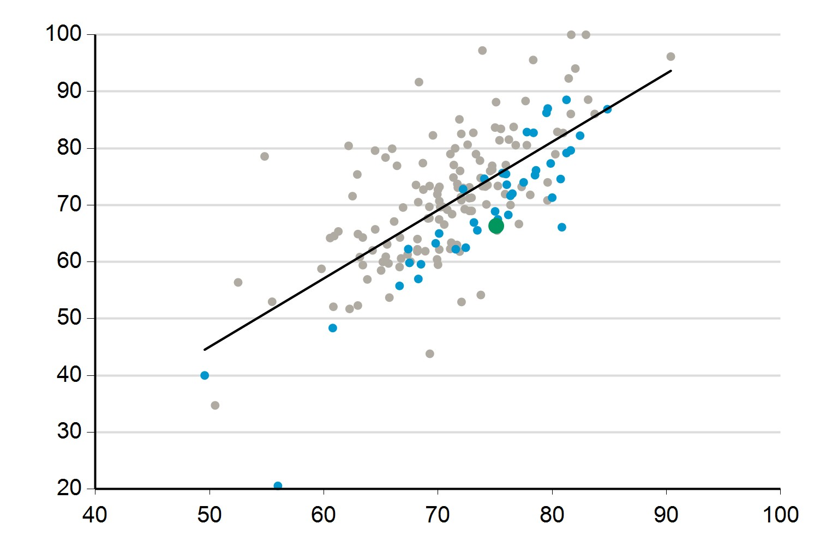
2. Key indicators
Diversity and engagement
13
Organisations that foster an environment of respect and inclusiveness have higher levels of engagement.
Key: • Kerang District Health
• Comparator organisations • Other organisations
Foster respect and inclusiveness questions
My organisation fosters an environment where all staff are treated fairly and with respect
My organisation fosters an environment of inclusiveness
Foster respect and inclusiveness
Average positive agreement %
Engagement index *
*Engagement index: Each respondent is given a score for each engagement question where strongly agree equates to 100 points, agree equates to 75 points, neither agree nor disagree equates to 50 points, disagree equates to 25 points and strongly disagree equates to 0 points. The engagement index is the average of these scores.

Slide 14
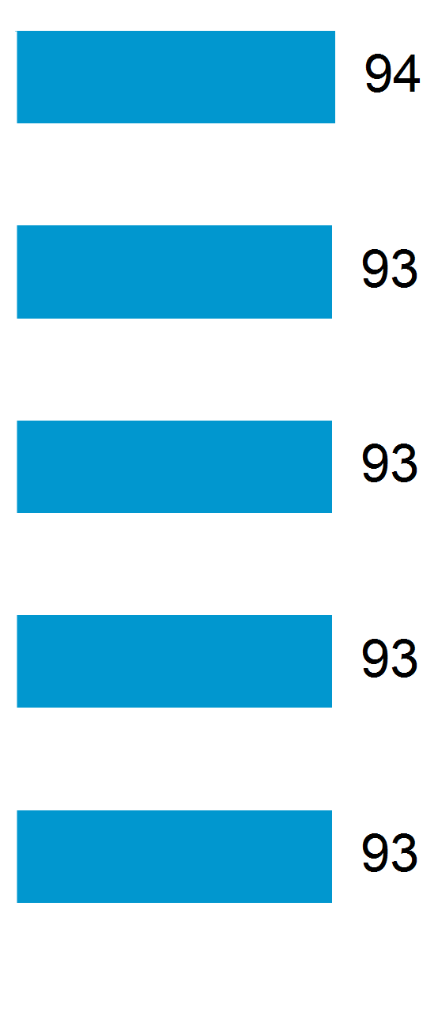
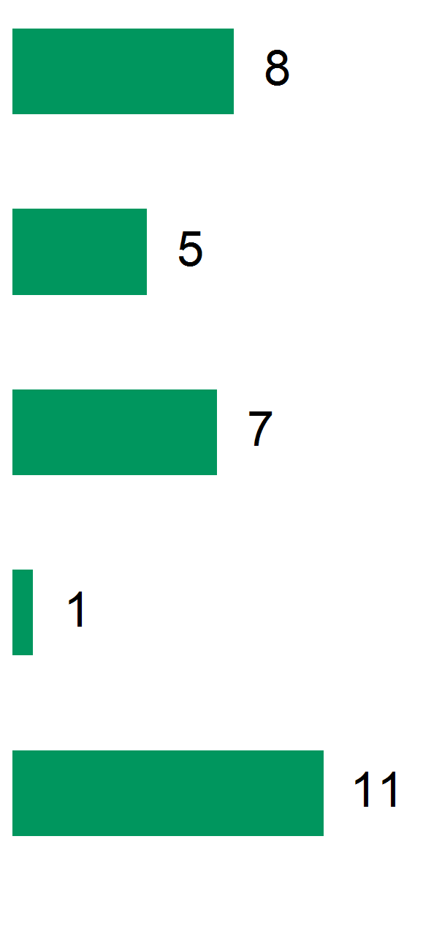
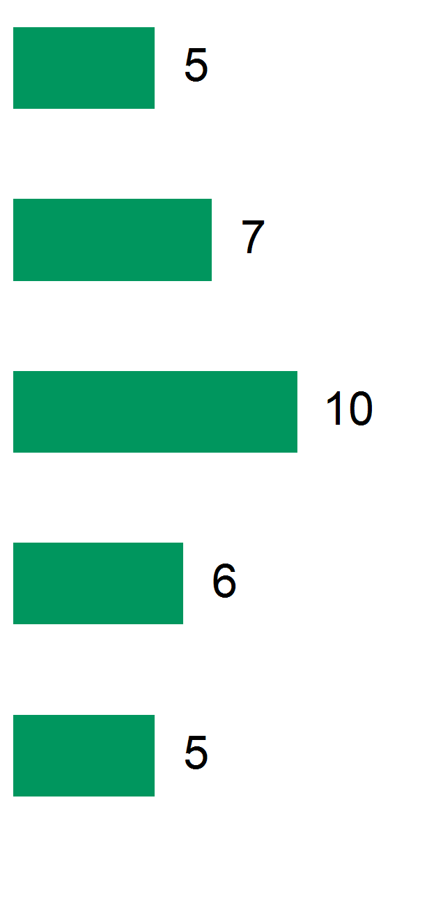
3. Question benchmarks
Highest scoring questions in 2018
14
These results are from questions that ask all survey respondents to provide an agreement rating.
Question
Your results
Something
Variance from comparator group
Variance from your 2017 survey
Average positive agreement %
There is a positive culture within my organisation in relation to employees of different sexes/genders
Cultural background is not a barrier to success in my organisation
Percentage point differences
Sexual orientation is not a barrier to success in my organisation
I have a clear understanding of how my own job contributes to my workgroup’s role
I would recommend a friend or relative to be treated as a patient here

Slide 15
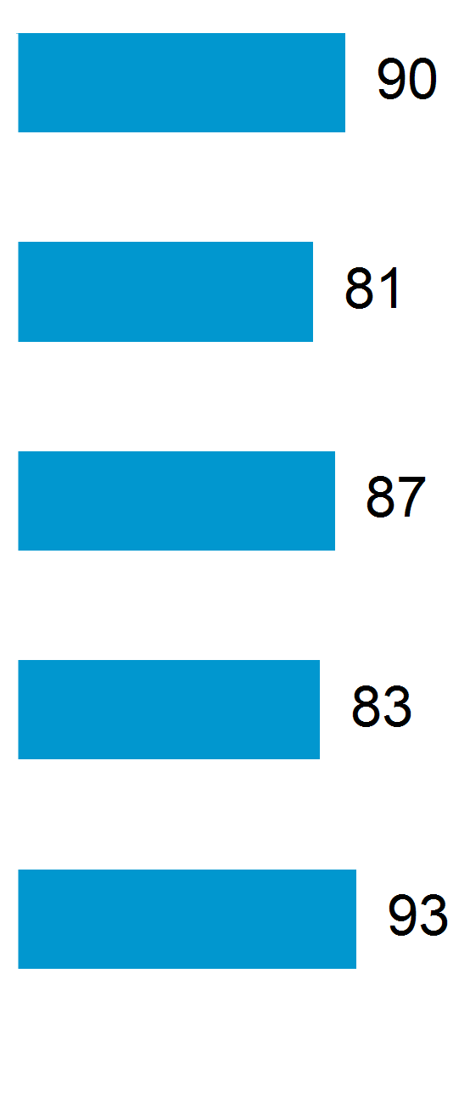
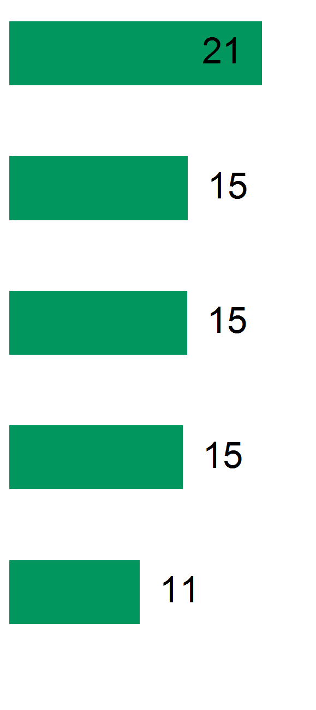
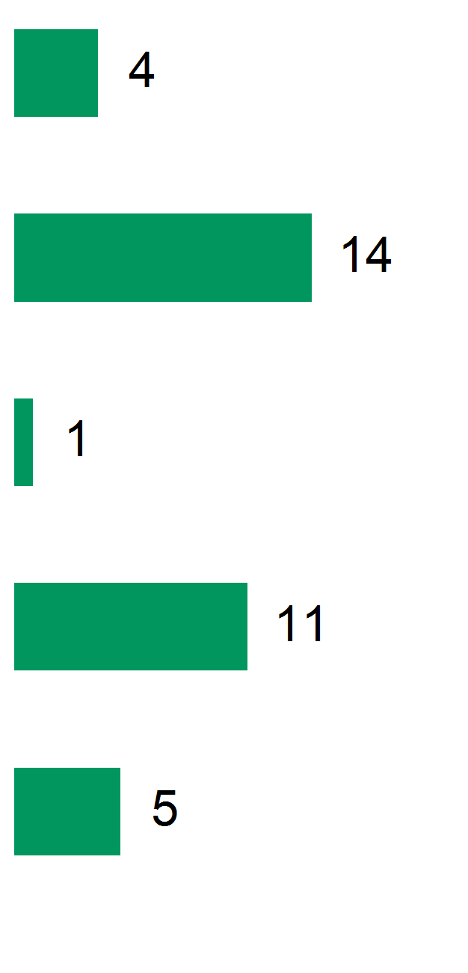
3. Question benchmarks
Highest scoring questions relative to comparator group
15
These results are from questions that ask all survey respondents to provide an agreement rating.
Question Your results
Average positive agreement %
There is a positive culture within my organisation in relation to employees who are Aboriginal and/or Torres Strait Islander
Trainees in my discipline are adequately supervised
Variance from comparator group
Variance from your 2017 survey
Percentage point differences
There is a positive culture within my organisation in relation to employees who identify as LGBTI (lesbian, gay, bisexual,
This health service does a good job of training new and existing staff
I would recommend a friend or relative to be treated as a patient here

Slide 16
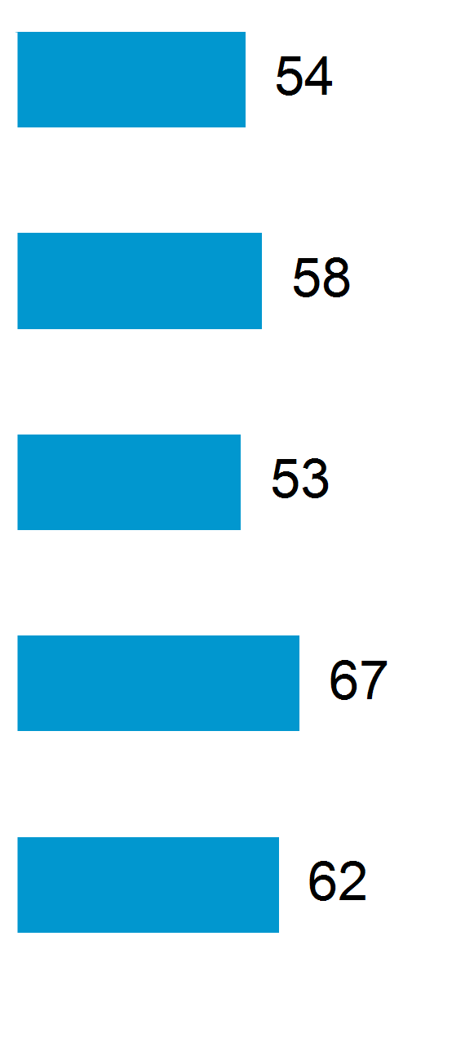
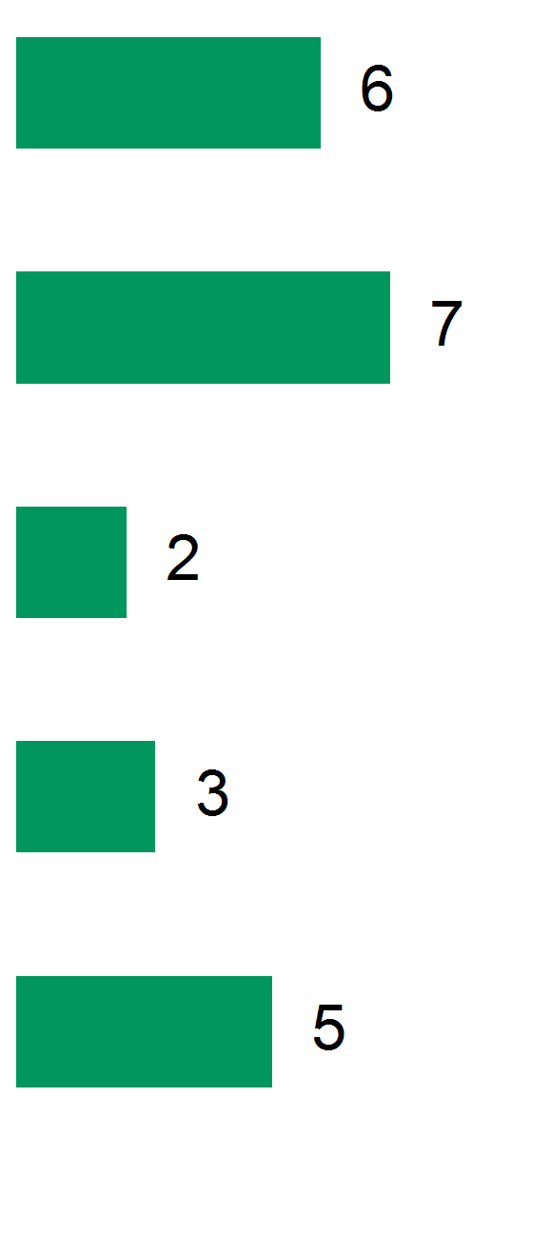
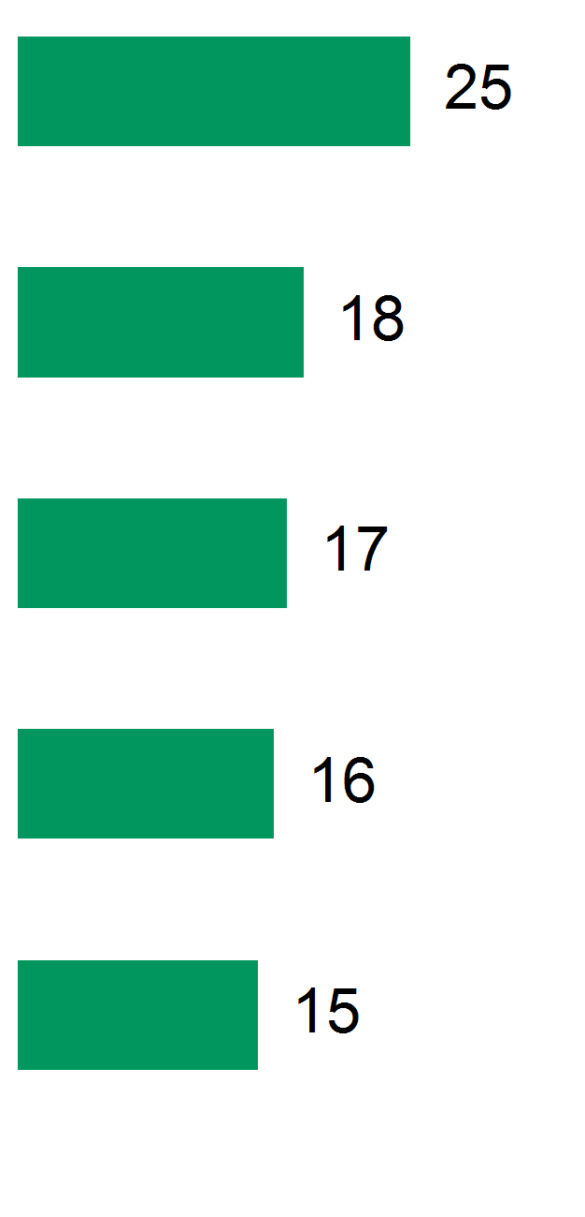
3. Question benchmarks
Questions with the most improvement on 2017
16
These results are from questions that ask all survey respondents to provide an agreement rating.
Question Your results
Average positive agreement %
Information about workplace psychological wellbeing is always brought to my attention by my immediate supervisor
In my workplace, there is good communication about psychological safety issues that affect me
In my organisation, employees are encouraged to become involved in psychological health matters
I receive adequate recognition for my contributions and accomplishments
Variance from comparator group
Variance from your 2017 survey
Percentage point differences
Senior managers show support for stress prevention through involvement and commitment

Slide 17
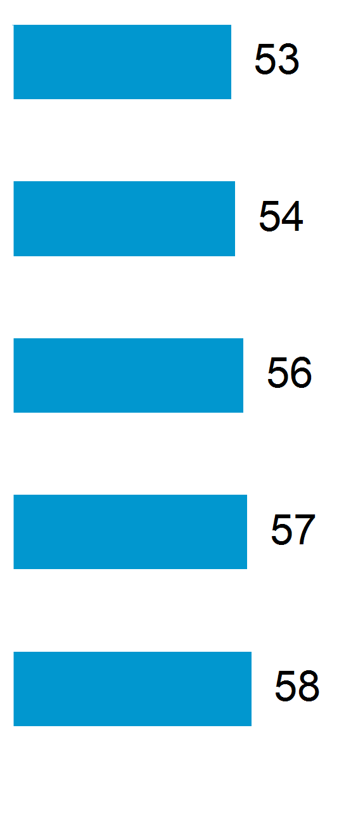
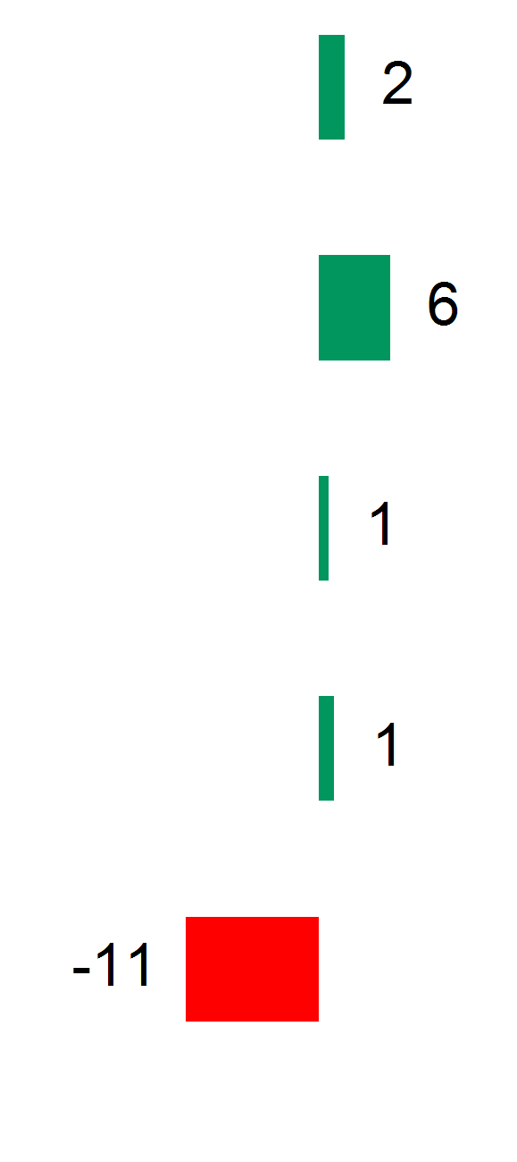
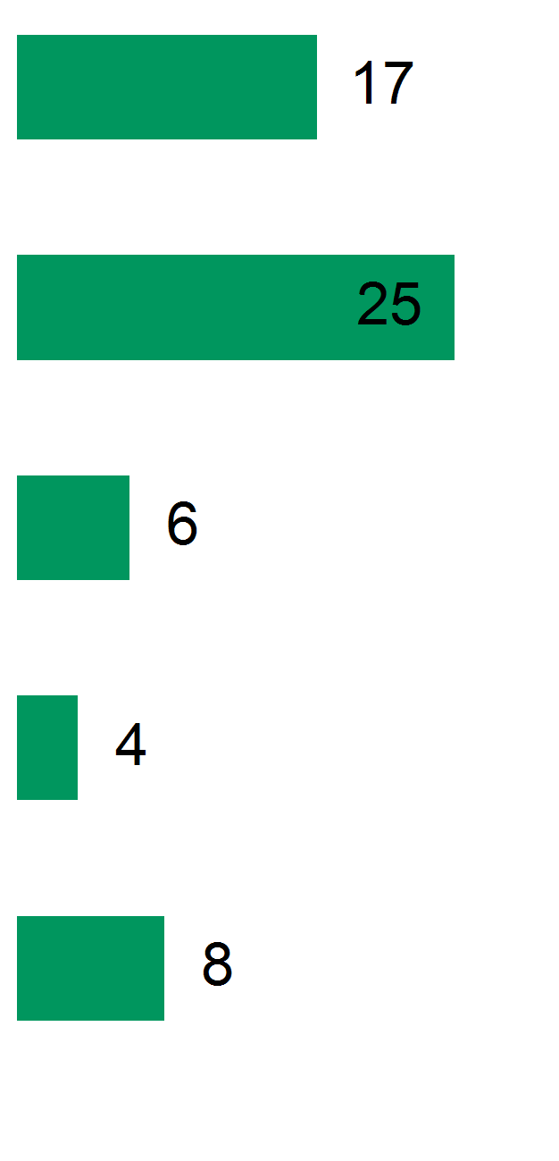
3. Question benchmarks
Lowest scoring questions in 2018
17
These results are from questions that ask all survey respondents to provide an agreement rating.
Question
Your results
Some
Variance from comparator group
Variance from your 2017 survey
Average positive agreement %
In my organisation, employees are encouraged to become involved in psychological health matters
Information about workplace psychological wellbeing is always brought to my attention by my immediate supervisor
In my organisation, senior managers consider the psychological health of employees to be as important as productivity
In my organisation, participation and consultation in psychological health and safety occurs with employees, unions, and health and
I am confident that I would be protected from reprisal for reporting improper conduct
Percentage point differences

Slide 18
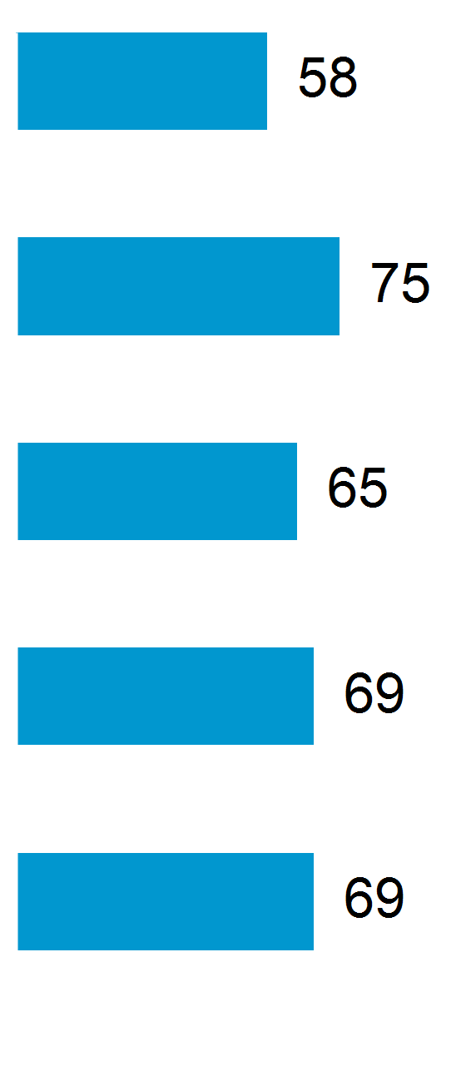
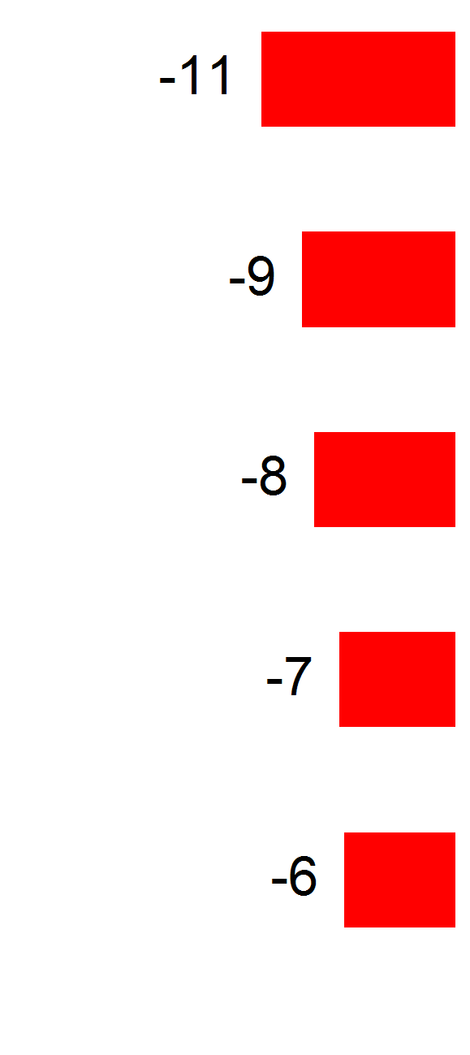
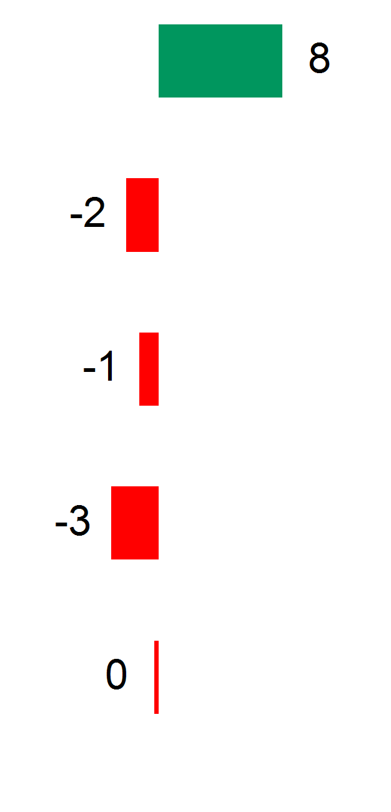
3. Question benchmarks
Lowest scoring questions relative to comparator group
18
These results are from questions that ask all survey respondents to provide an agreement rating.
Question Your results
Average positive agreement %
I am confident that I would be protected from reprisal for reporting improper conduct
Variance from comparator group
Variance from your 2017 survey
Percentage point differences
In my workgroup, human rights are valued
People in my workgroup treat each other with respect
My manager involves me in decisions about my work
People in my workgroup are honest, open and transparent in their dealings

Slide 19
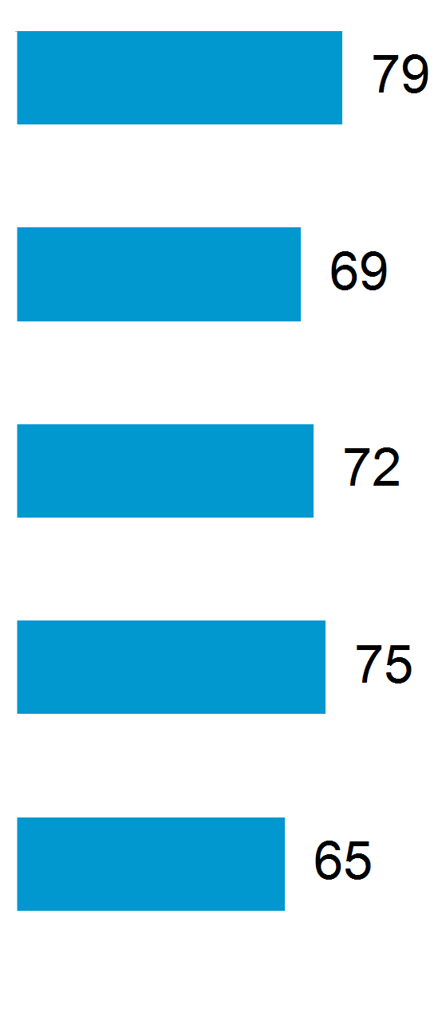
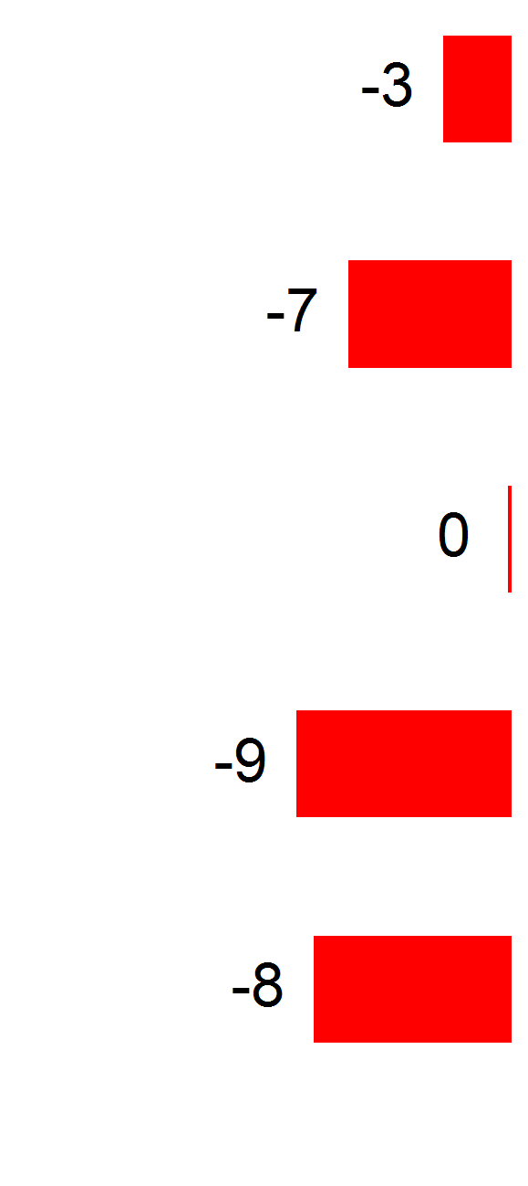
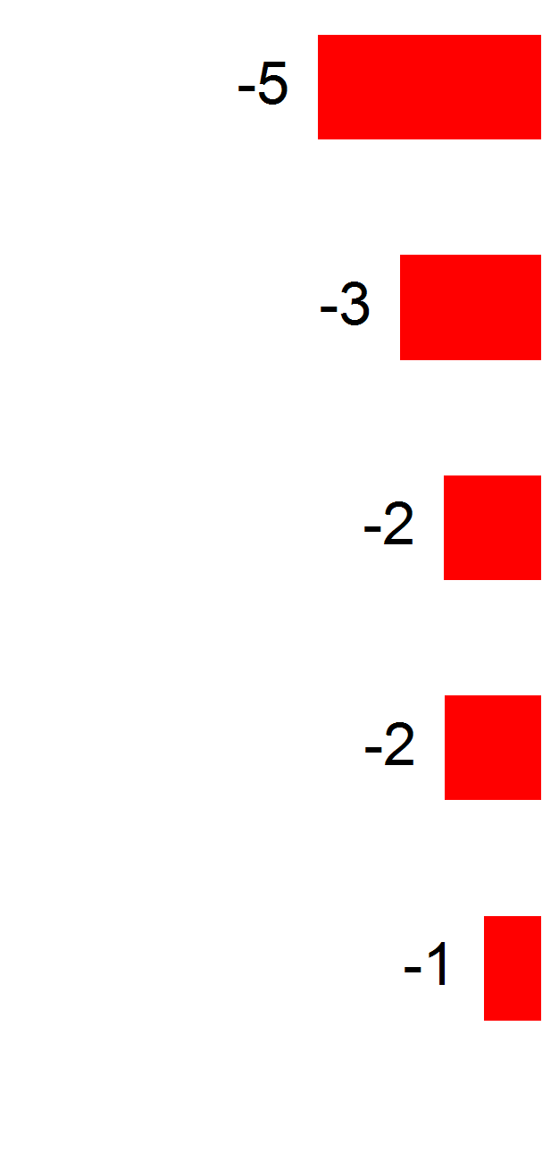
3. Question benchmarks
Questions with the greatest deterioration on 2017
19
These results are from questions that ask all survey respondents to provide an agreement rating.
Question Your results
Average positive agreement %
My workgroup always tries to improve its performance
Variance from comparator group
Variance from your 2017 survey
Percentage point differences
My manager involves me in decisions about my work
My manager keeps me informed about what’s going on
In my workgroup, human rights are valued
People in my workgroup treat each other with respect

